Slide 1
PGVCL Training
Day-3

Slide 2
Flutter Training for PGVCL Department
Day 3: Material design and Cupertino Widgets

Slide 3
Overview
Topics We’ll Be Covering For Today
Theory
Material Design and Cupertino Widgets overview
When to use Material vs. Cupertino
Assignment:
Create a hybrid app using Material Design for Android and Cupertino for iOSpage
Practical
Build an app with Material components: AppBar, Scaffold, Buttons, and TextField.
Build a simple app with Cupertino Widgets.

Slide 4
Material Design and Cupertino Widget
A design system developed by Google focused on creating consistent, adaptable UIs.
Key Features:
Grid-based layouts.
Responsive animations.
Material components: buttons, cards, app bars, etc.
Images:
Examples of Material Design widgets: Elevated Button, FloatingActionButton, and AppBar.
Add a Material Design color palette.

Slide 5
Material design widgets in Flutter
Examples
Elevated Button
AppBar
BottomNavigationBar
FloatingActionButton

Slide 6
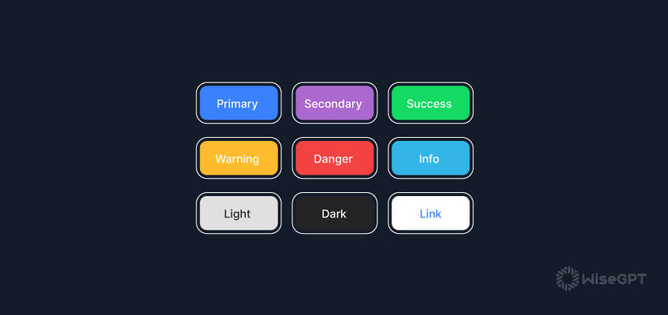
Elevated Button Images:

Slide 7
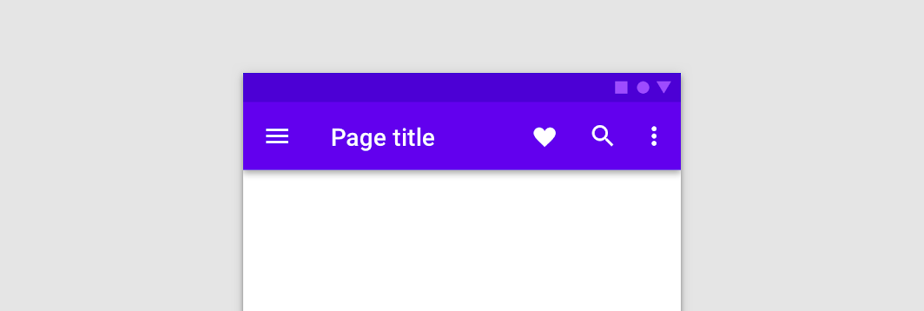
Apbar image:

Slide 8
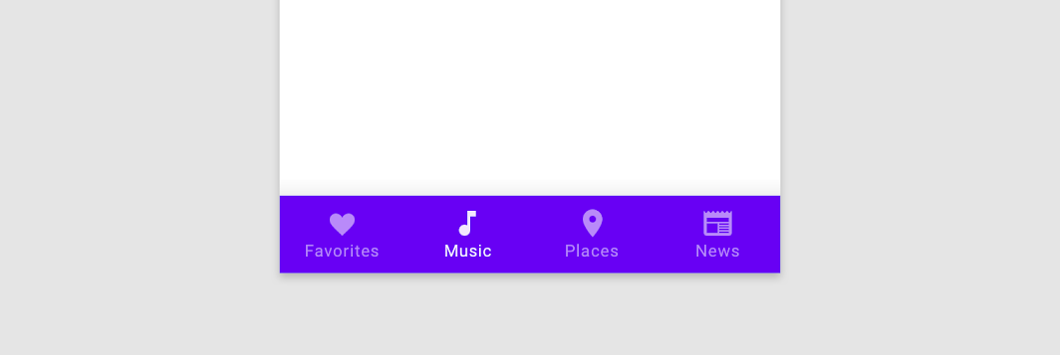
Bottom Navigation bar:

Slide 9
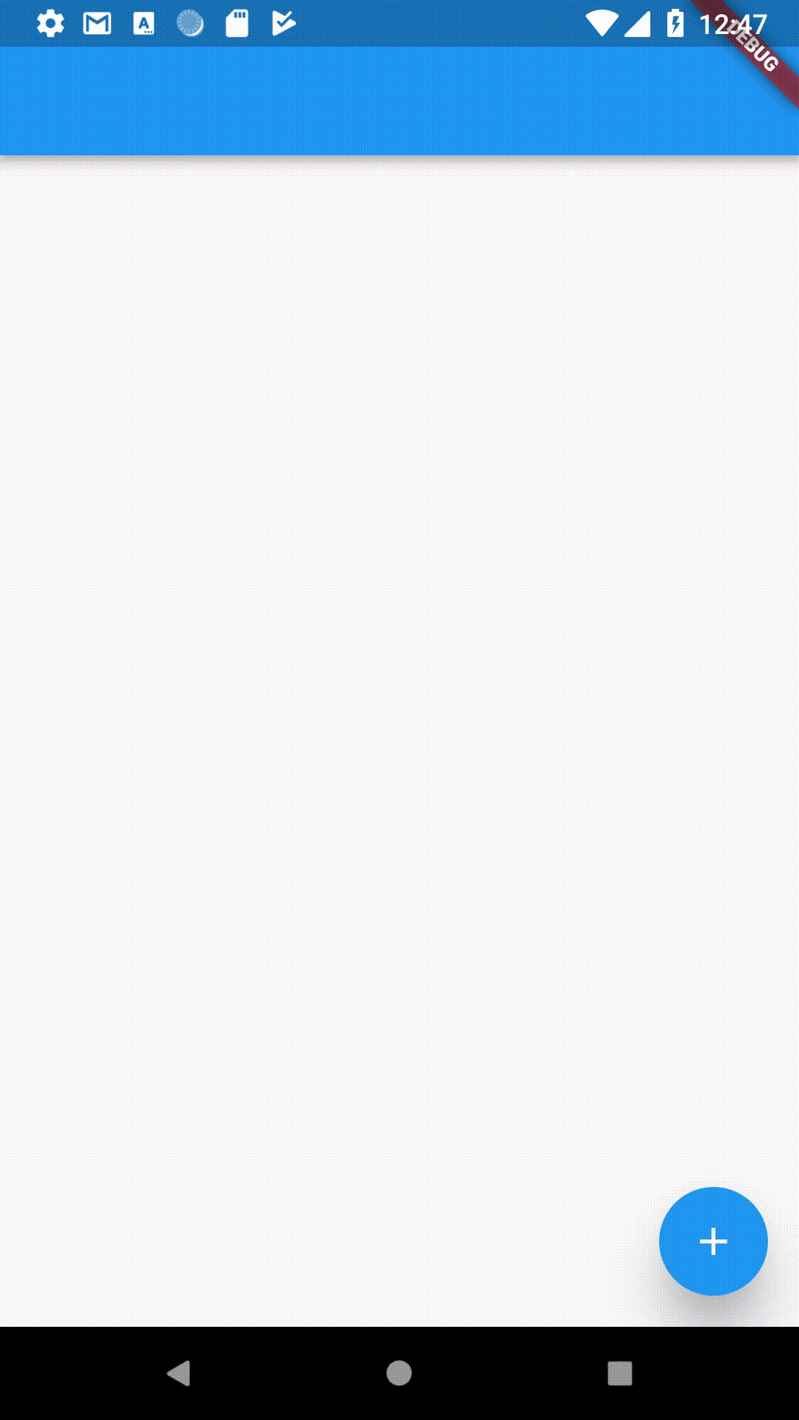
Floating Action Button:

Slide 10
What is Cupertino Design
A design system by Apple focusing on minimalistic and visually appealing UIs for iOS.
Key Features:
Rounded edges and smooth transitions.
Native iOS look and feel.

Slide 11
Cupertino design widgets in Flutter
Examples
Cupertino Button
Cupertino Navigation Bar
Cupertino Tab Scaffold

Slide 12
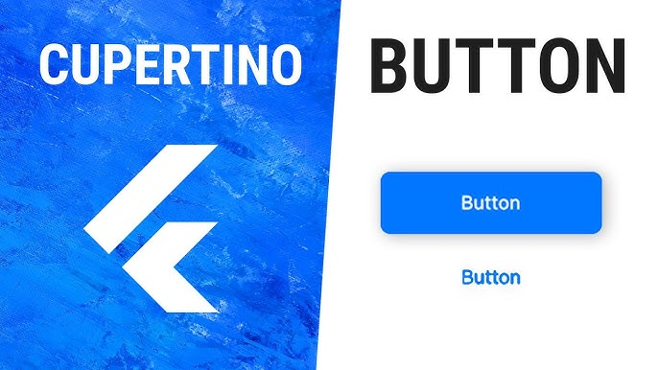
Cupertino Button Images:

Slide 13
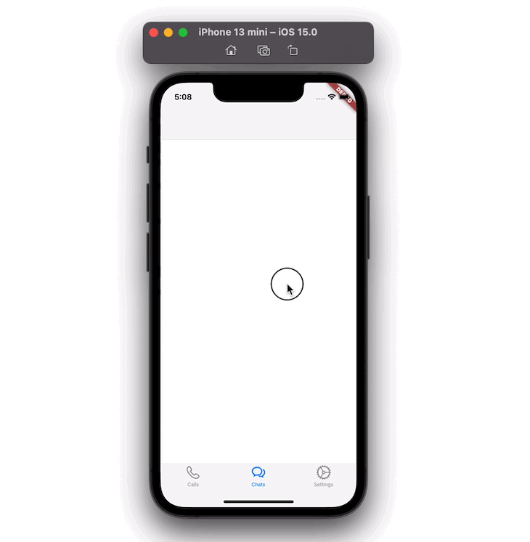
Cupertino Navigation Bar Images:

Slide 14
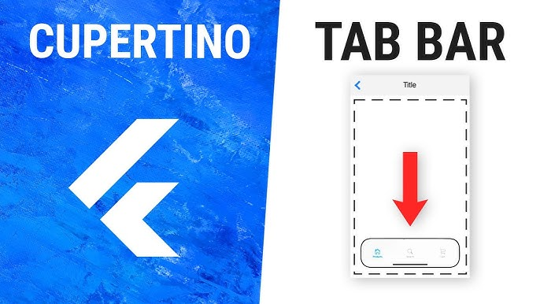
Cupertino Tab Scaffolfd Images:

Slide 15
Cupertino Button Images:

Slide 16
Material vs Cupertino
Design Philosophy:
Material (bold, colorful) vs.
Cupertino (minimal, elegant).
Platform Target:
Material (Android) vs.
Cupertino (iOS).
Customization:
Material is more flexible.
Widgets Example:
Material: ElevatedButton, AppBar.
Cupertino: CupertinoButton, CupertinoNavigationBar.

Slide 17
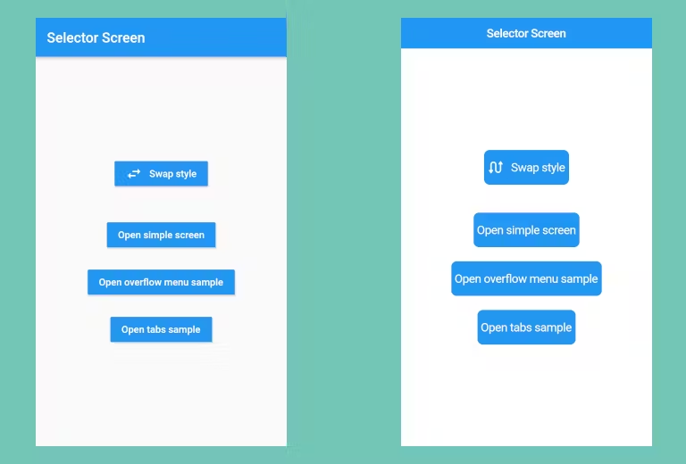
Material vs cupertino

Slide 18
Combining Material and Cupertino Widgets
Why Combine?
Create apps that feel native on both platforms.
Approach:
Use Platform.isIOS and Platform.isAndroid for platform-specific logic.
Use adaptive widgets like Switch.adaptive or Scaffold.

Slide 19
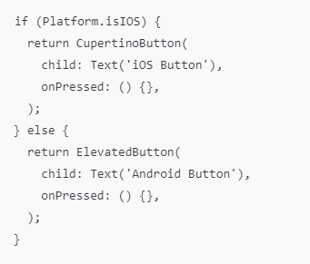

Slide 20
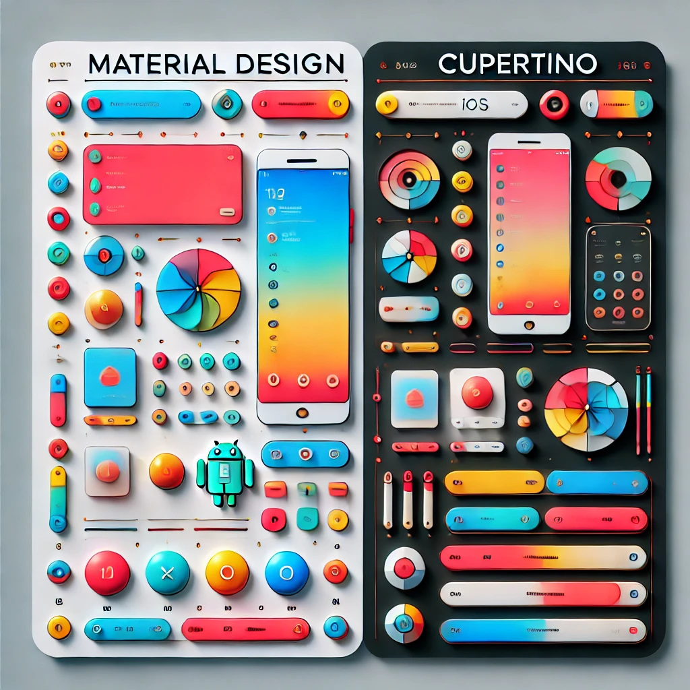

Slide 21
Practical Example
Link
Assignment Example
Create a basic UI with 3 Stateless Widgets and 2 Stateful Widgets

